Slide 1
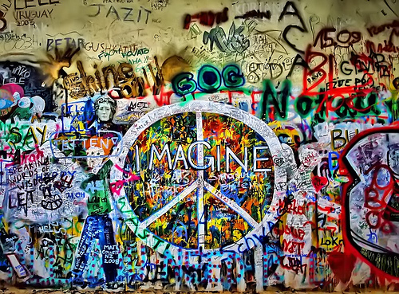
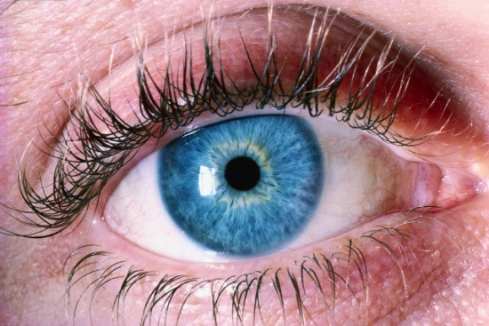
http://www.flickr.com/photos/julianomattos/3616862018/sizes/m/in/photostream//

Slide 2
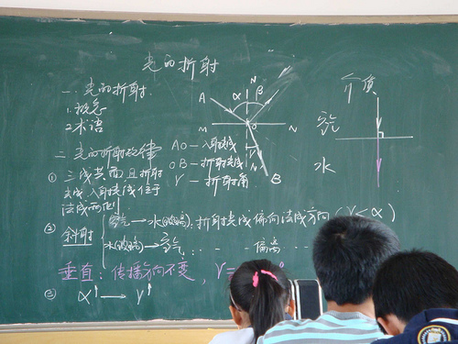
a place where people learn…
http://www.flickr.com/photos/tianhua/3693686518/sizes/m/in/photostream/

Slide 3
... to smile…

Slide 4
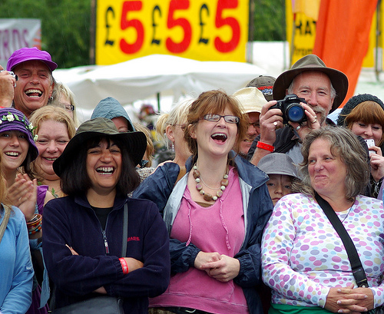
…to laugh…
http://www.flickr.com/photos/lovestruck94/3772514705/sizes/m/in/photostream/

Slide 5
…to play…
http://www.flickr.com/photos/alpertecer/4103986832/sizes/m/in/photostream/

Slide 6
… to build…
http://www.flickr.com/photos/usnavy/5809460206/sizes/m/in/photostream/

Slide 7
… to construct…
http://www.flickr.com/photos/nrg07/4625170871/sizes/m/in/photostream/

Slide 8
… to create…
http://www.flickr.com/photos/25802865@N08/7891345672/sizes/m/in/photostream/

Slide 9
… to
communicate…
http://www.flickr.com/photos/chimothy27/3487954077/sizes/m/in/photostream/

Slide 10
… to
listen…
http://www.flickr.com/photos/alpertecer/4103986832/sizes/m/in/photostream/

Slide 11
… to
read…

Slide 12
… to interact…
http://www.flickr.com/photos/photonquantique/4259803340/

Slide 13
… to work together…
http://www.flickr.com/photos/laowaikevin/4115681044/sizes/m/in/photostream/

Slide 14
… to experiment…
http://www.flickr.com/photos/hpk/90303535/sizes/m/in/photostream/

Slide 15
… to think…
http://www.flickr.com/photos/tmartin/71654890/sizes/m/in/photostream/

Slide 16
… to
http://www.flickr.com/photos/markstos/3850867460/sizes/m/in/photostream/
question…

Slide 17
http://www.flickr.com/photos/photonquantique/7635963872/sizes/m/in/photostream/
… to connect…

Slide 18
… to
inquire…
http://www.flickr.com/photos/pmorgan/3344693/sizes/m/in/photostream/

Slide 19
… to understand.

Slide 20
I imagine blended learning.
http://www.flickr.com/photos/gforsythe/7704609288/sizes/m/in/photostream/

